Slide 1
Predictive Model for Electricity Price Forecasting
Empowering Informed Energy Decision
Sakthiswathi G,
III-CSE,
VVCET.

Slide 2
ABSTRACTION:
Data collection
Data processing
Feature Engineering
Model selection
Model training
Evaluation Metrices
Model performance

Slide 3
INTRODUCTION:
Introduce the problem: forecasting future electricity prices.
Highlight the objectives: assisting energy providers and consumers in decision-making.
Mention the key project phases: data preprocessing, feature engineering, model selection, training, and evaluation.

Slide 4
Problem Statement:
Define the problem of electricity price forecasting.
Explain why it's essential for energy providers and consumers.

Slide 5
Data Collection
Describe the need for historical electricity prices and relevant factors.
Mention potential data sources (market data, weather data, demand, supply).

Slide 6
Data Preprocessing
Explain the importance of data cleaning and preparation.
Highlight tasks like handling missing values and scaling features.

Slide 7
Feature Engineering
Discuss the creation of additional features capturing price influencers.
Emphasize capturing seasonality, external factors, and demand patterns.

Slide 8
Model Selection
Explain the process of choosing the right forecasting model.
List suitable models (e.g., Time Series models, Machine Learning algorithms).

Slide 9
Model Training
Describe the training phase for the selected model.
Mention that it uses the preprocessed data.

Slide 10
Evaluation Metrics
Introduce evaluation metrics (e.g., Mean Absolute Error, Root Mean Squared Error) to assess model performance.

Slide 11
Model Performance
Display model evaluation results using visuals.
Discuss how the results reflect the model's accuracy in predicting electricity prices.

Slide 12
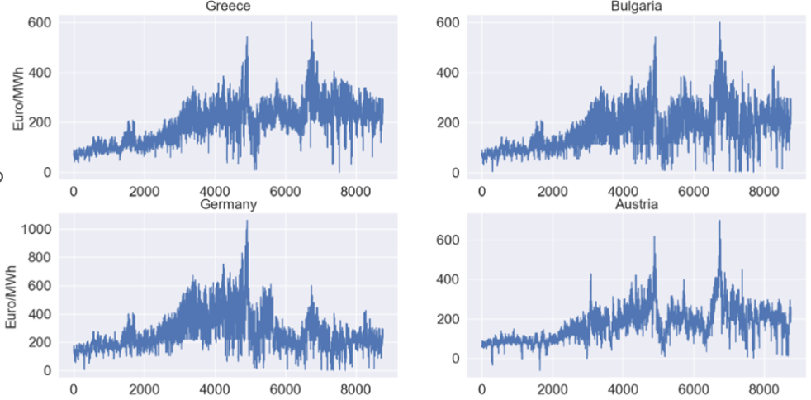
The below Bar chart shows the electricity prices for 4 different countries.

Slide 13
Applications
Discuss how the predictive model can assist energy providers and consumers.
Mention informed decision-making, consumption optimization, and investment planning.

Slide 14
Conclusion
Summarize the key steps in developing the predictive model.
Reiterate the importance of accurate electricity price forecasting

Slide 15
Future Work
Mention potential areas for improvement or future developments in the project.

Slide 16
THANK YOU!

